Slide 1
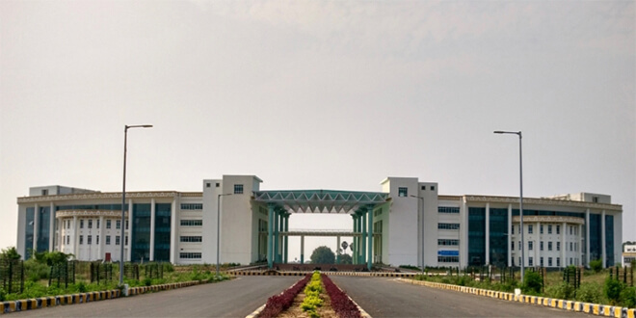

CQL (Cassandra Query Language)
Dr. Rajiv Misra
Dept. of Computer Science & Engg.
Indian Institute of Technology Patna
rajivm@iitp.ac.in
Big Data Computing
CQL

Slide 2
Preface
Content of this Lecture:
In this lecture, we will discuss CQL (Cassandra Query Language) Mapping to Cassandra's Internal Data Structure.
Big Data Computing
CQL

Slide 3
What Problems does CQL Solve?
The Awesomeness that is Cassandra:
Distributed columnar data store
No single point of failure
Optimized for availability (through “Tunably” consistent
Optimized for writes
Easily maintainable
Almost infinitely scalable
Big Data Computing
CQL

Slide 4
What Problems does CQL Solve? (Contd.)
Cassandra’s usability challenges
NoSQL: “Where are my JOINS? No Schema? De-normalize!?”
BigTable: “Tables with millions of columns!?”
CQL Saves the day!
A best-practices interface to Cassandra
Uses familiar SQL-Like language
Big Data Computing
CQL

Slide 5
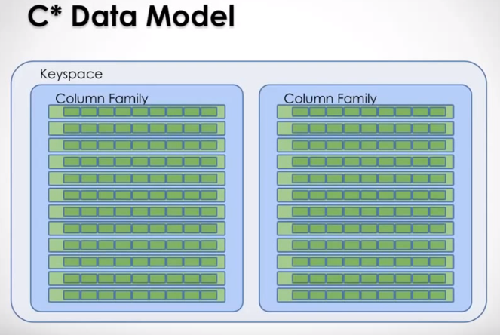
C* Data Model
Big Data Computing
CQL

Slide 6
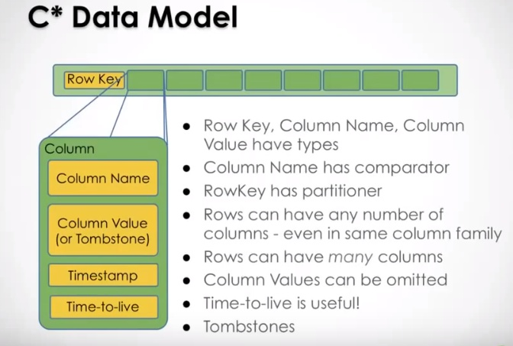
C* Data Model (Contd.)
Row Key, Column Name, Column Value have types
Column Name has comparator
RowKey has partitioner
Rows can have any number of columns - even in same column family
Rows can have many columns
Column Values can be omitted
Time-to-live is useful!
Tombstones
Big Data Computing
CQL

Slide 7
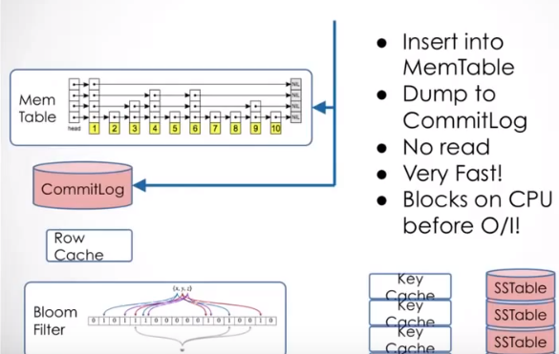
C* Data Model: Writes
Insert into
MemTable
Dump to
CommitLog
No read
Very Fast!
Blocks on CPU
before O/I!
Big Data Computing
CQL

Slide 8
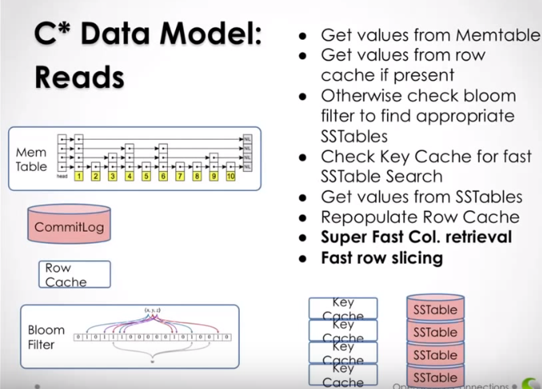
C* Data Model: Reads
Get values from Memtable
Get values from row cache if present
Otherwise check bloom filter to find appropriate SSTables
Check Key Cache for fast SSTable Search
Get values from SSTables
Repopulate Row Cache
Super Fast Col. retrieval
Fast row slicing
Big Data Computing
CQL

Slide 9
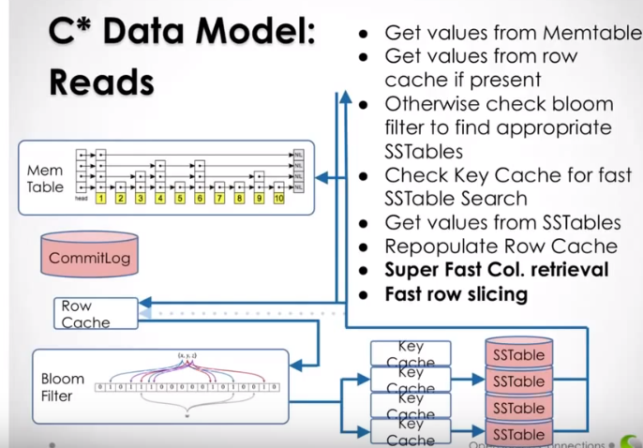
C* Data Model: Reads (Contd.)
Get values from Memtable
Get values from row cache if present
Otherwise check bloom filter to find appropriate SSTables
Check Key Cache for fast SSTable Search
Get values from SSTables
Repopulate Row Cache
Super Fast Col. retrieval
Fast row slicing
Big Data Computing
CQL

Slide 10
Introducing CQL
CQL is a reintroduction of schema so that you don’t have to read code to understand the data model.
CQL creates a common language so that details of the data model can be easily communicated.
CQL is a best-practices Cassandra interface and hides the messy details.
Big Data Computing
CQL

Slide 11
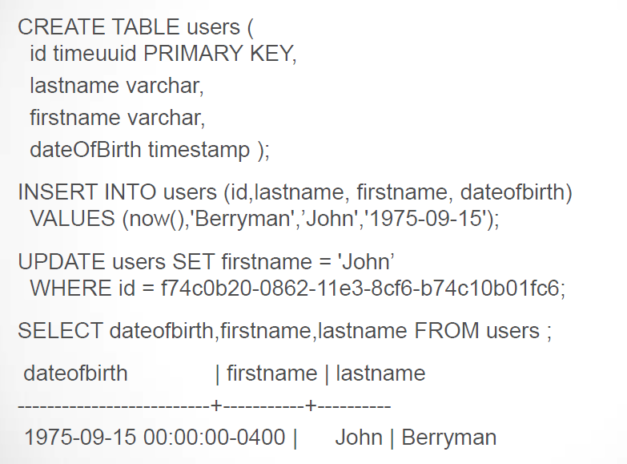
Introducing CQL (Contd.)
Big Data Computing
CQL

Slide 12
Remember this:
Cassandra finds rows fast
Cassandra scans columns fast
Cassandra does not scan rows
Big Data Computing
CQL

Slide 13
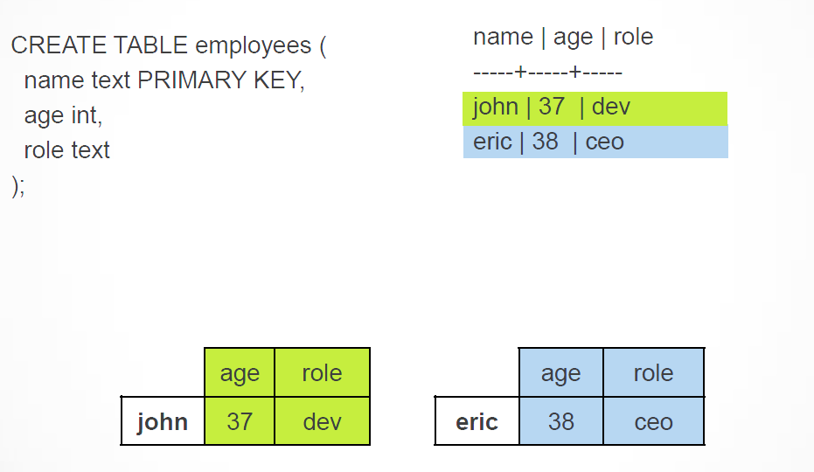
The CQL/Cassandra Mapping
Big Data Computing
CQL

Slide 14
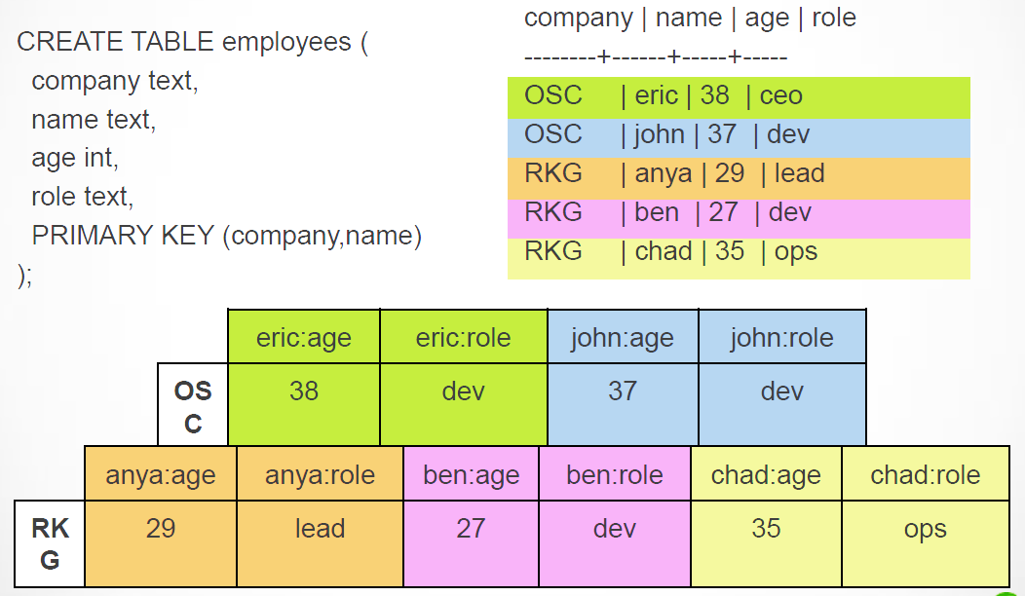
The CQL/Cassandra Mapping
Big Data Computing
CQL

Slide 15
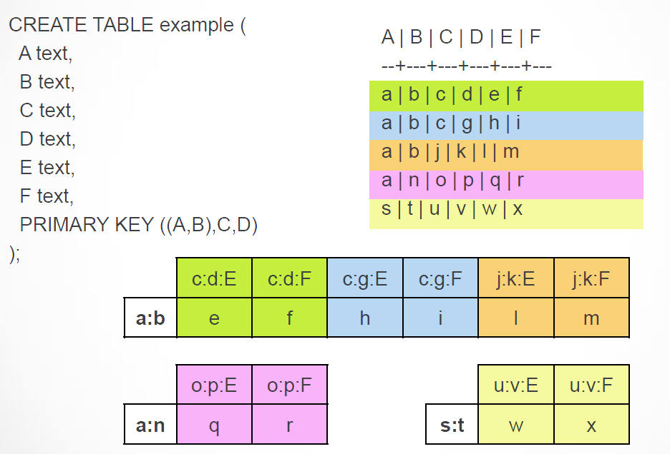
The CQL/Cassandra Mapping (Contd.)
Big Data Computing
CQL

Slide 16
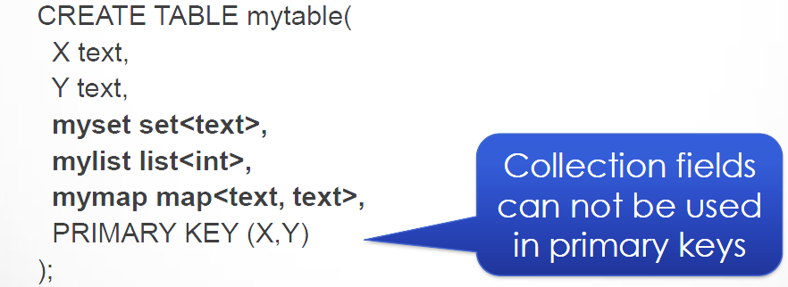
CQL for Sets, Lists and Maps
Collection Semantics
Sets hold list of unique elements
Lists hold ordered, possibly repeating elements
Maps hold a list of key-value pairs
Uses same old Cassandra datastructure
Declaring
Big Data Computing
CQL

Slide 17
Inserting
INSERT INTO mytable (row, myset)
VALUES (123, { ‘apple’, ‘banana’});
INSERT INTO mytable (row, mylist)
VALUES (123, [‘apple’,’banana’,’apple’]);
INSERT INTO mytable (row, mymap)
VALUES (123, {1:’apple’,2:’banana’})
Big Data Computing
CQL

Slide 18
Updating
UPDATE mytable SET myset = myset + {‘apple’,‘banana’}
WHERE row = 123;
UPDATE mytable SET myset = myset - { ‘apple’ }
WHERE row = 123;
UPDATE mytable SET mylist = mylist + [‘apple’,‘banana’]
WHERE row = 123;
UPDATE mytable SET mylist = [‘banana’] + mylist
WHERE row = 123;
UPDATE mytable SET mymap[‘fruit’] = ‘apple’
WHERE row = 123
UPDATE mytable SET mymap = mymap + { ‘fruit’:‘apple’}
WHERE row = 123
Big Data Computing
CQL

Slide 19
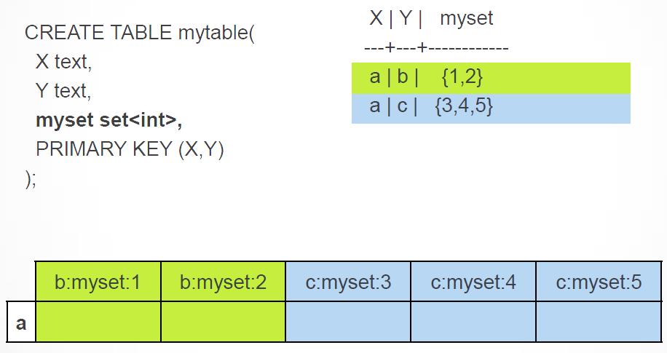
SETS
Big Data Computing
CQL

Slide 20
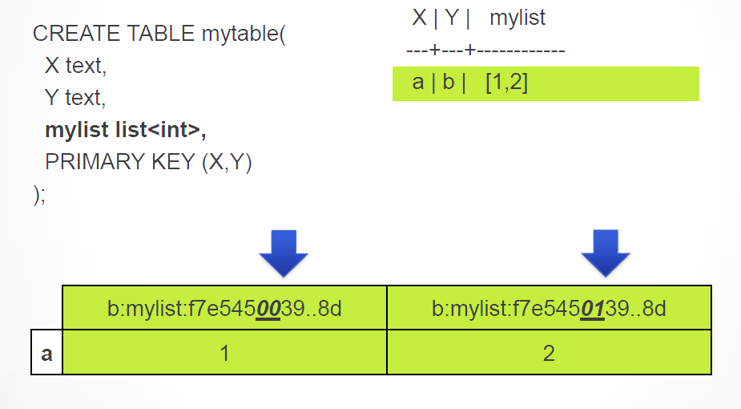
LISTS
Big Data Computing
CQL

Slide 21
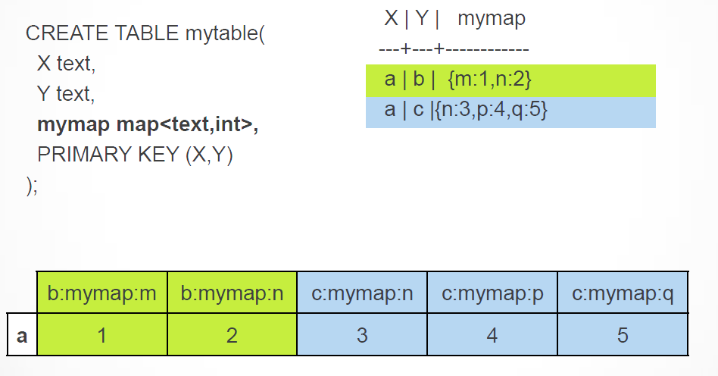
MAPS
Big Data Computing
CQL

Slide 22
Example
(in cqlsh)
CREATE KEYSPACE test WITH replication =
{'class': 'SimpleStrategy', 'replication_factor': 1};
USE test;
CREATE TABLE stuff ( a int, b int, myset set<int>,
mylist list<int>, mymap map<int,int>, PRIMARY KEY (a,b));
UPDATE stuff SET myset = {1,2}, mylist = [3,4,5], mymap = {6:7,8:9} WHERE a = 0
AND b = 1;
SELECT * FROM stuff;
(in cassandra-cli)
use test;
list stuff ;
(in cqlsh)
SELECT key_aliases,column_aliases from system.schema_columnfamilies WHERE
keyspace_name = 'test' AND columnfamily_name = 'stuff';
Big Data Computing
CQL

Slide 23
Conclusion
CQL is a reintroduction of schema
CQL creates a common data modeling language
CQL is a best-practices Cassandra interface
CQL let’s you take advantage of the C* Data structure
CQL protocol is binary and therefore interoperable with any language
CQL is asynchronous and fast (Thrift transport layer is synchronous)
CQL allows the possibility for prepared statements
Big Data Computing
CQL

